Slide 1
Malignant Commentes Classifier - Multi Label Classification Project using NLP
Prepared by :
Vikash Kumar Singh

Slide 2


Slide 3
Malignant Commentes Classifier - Multi Label Classification Project using NLP
The proliferation of social media enables people to express their opinions widely online. However, at the same time, this has resulted in the emergence of conflict and hate, making online environments uninviting for users. Although researchers have found that hate is a problem across multiple platforms, there is a lack of models for online hate detection.
Online hate, described as abusive language, aggression, cyberbullying, hatefulness and many others has been identified as a major threat on online social media platforms. Social media platforms are the most prominent grounds for such toxic behavior.

Slide 4
Malignant Commentes Classifier - Multi Label Classification Project using NLP
There has been a remarkable increase in the cases of cyberbullying and trolls on various social media platforms. Many celebrities and influences are facing backlashes from people and have to come across hateful and offensive comments. This can take a toll on anyone and affect them mentally leading to depression, mental illness, self-hatred and suicidal thoughts.
Internet comments are bastions of hatred and vitriol. While online anonymity has provided a new outlet for aggression and hate speech, machine learning can be used to fight it. The problem we sought to solve was the tagging of internet comments that are aggressive towards other users. This means that insults to third parties such as celebrities will be tagged as unoffensive, but “u are an idiot” is clearly offensive.

Slide 5
Problem Statement
Our goal is to build a prototype of online hate and abuse comment classifier which can used to classify hate and offensive comments so that it can be controlled and restricted from spreading hatred and cyberbullying.

Slide 6
Multi –Label Classification Problem
Difference between multi-class classification & multi-label classification is that in multi-class problems the classes are mutually exclusive, whereas for multi-label problems each label represents a different classification task, but the tasks are somehow related.
For example, multi-class classification makes the assumption that each sample is assigned to one and only one label: a fruit can be either an apple or a pear but not both at the same time. Whereas, an instance of multi-label classification can be that a text might be about any of religion, politics, finance or education at the same time or none of these.

Slide 7
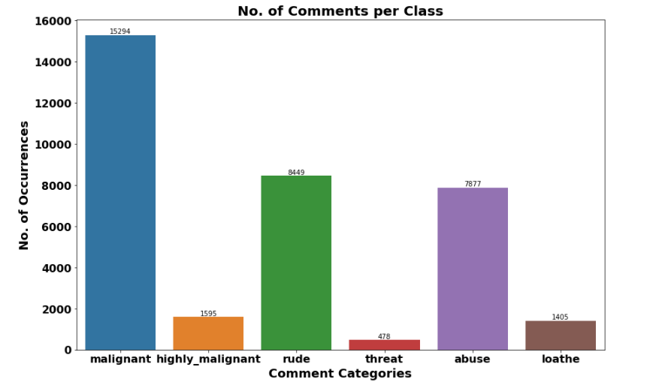
Exploration of Target Variable Ratings
Out of total Negative comments the maximum negative comments come with Malignant in nature followed by rude categories.
Around 90% comments are Good/Neutral in nature while rest 10% comments are Negative in nature.
Very few comments come with threatening nature.

Slide 8
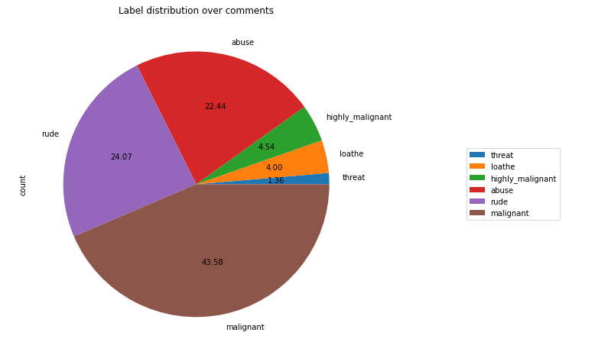
Out of total negative comments around 43.58% are malignant in nature followed by 24.07% are rude comments

Slide 9
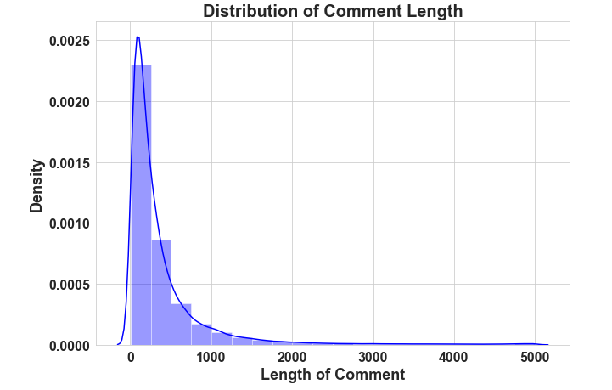
Above is a plot showing the comment length frequency. As noticed, most of the comments are short with only a few comments longer than 1000 words.
Majority of the comments are of length 500, where maximum length is 5000 and minimum length is 5. Median length being 250.

Slide 10
Data Pre Processing
Convert the text to lowercase
Remove the punctuations, digits and special characters
Tokenize the text, filter out the adjectives used in the review and create a new column in data frame
Remove the stop words
Stemming and Lemmatising
Applying Text Vectorization to convert text into numeric

Slide 11
Word Cloud for getting word sense
Word Cloud is a visualization technique for text data wherein each word is picturized with its importance in the context or its frequency.
The more commonly the term appears within the text being analysed, the larger the word appears in the image generated.
The enlarged texts are the greatest number of words used there and small texts are the smaller number of words used.

Slide 12
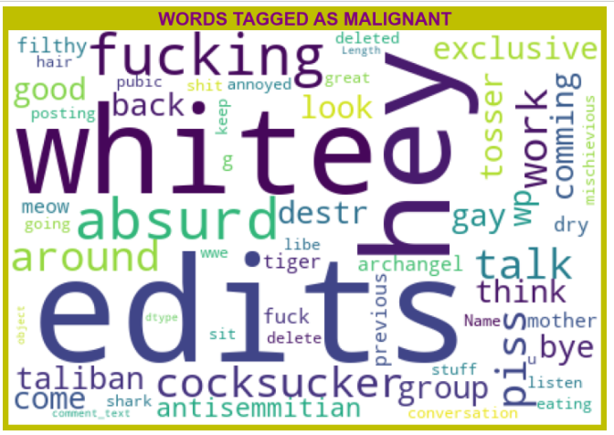
From word cloud of malignant comments, it is clear that it mostly consists of words like edits, hey, white, fucking, gay, cocksucker, work, think, Taliban etc

Slide 13
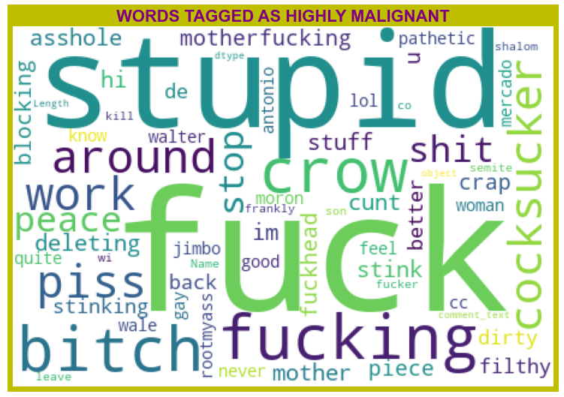
From word cloud of Highly malignant comments, it is clear that it mostly consists of words like fuck, stupid, fucking, bitch, crow, shit, cocksucker etc

Slide 14
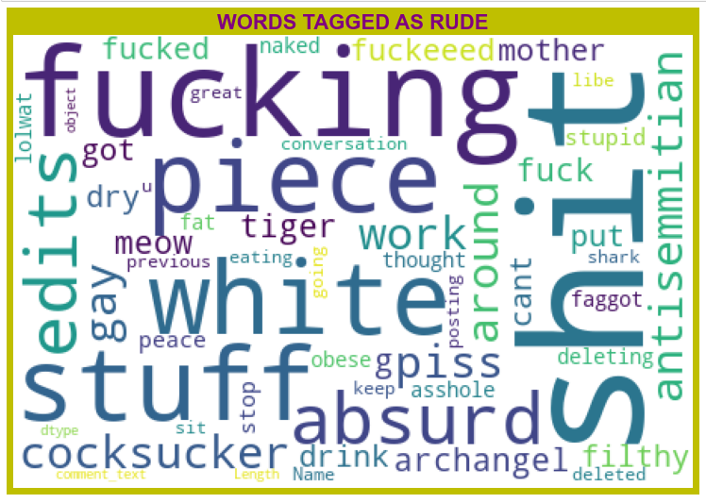
From word cloud of Rude comments, it is clear that it mostly consists of words like fucking, shit, white, piece, edits, stuff, absurd etc.

Slide 15
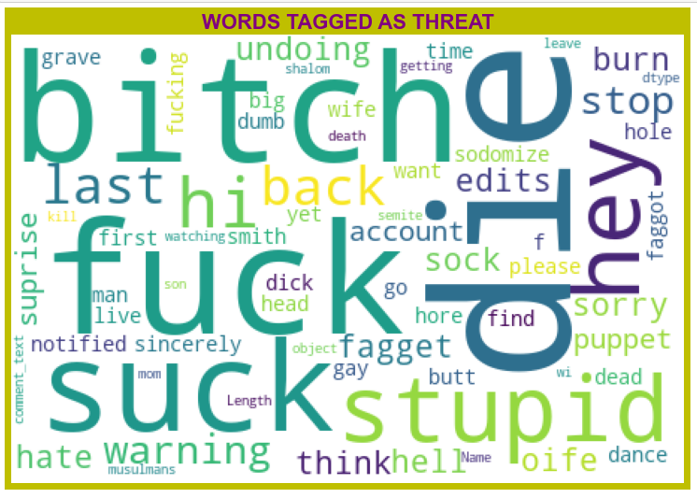
From word cloud of Threat comments, it is clear that it mostly consists of words like fuck, suck, Bitch, die, stupid, etc.

Slide 16
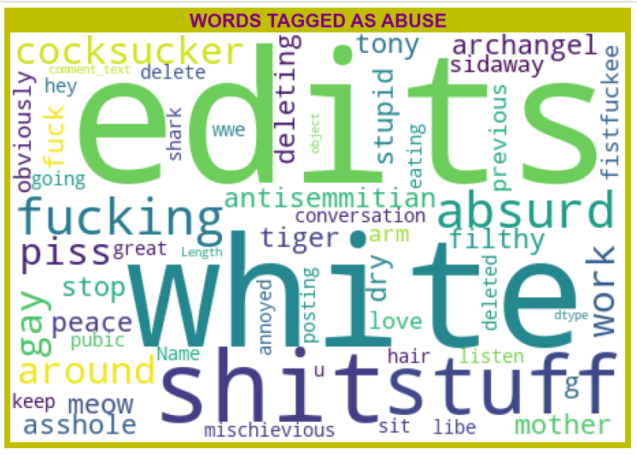
From word cloud of Abuse comments, it is clear that it mostly consists of words like edits, white, shit, stuff, fuck, piss, fucking etc.

Slide 17
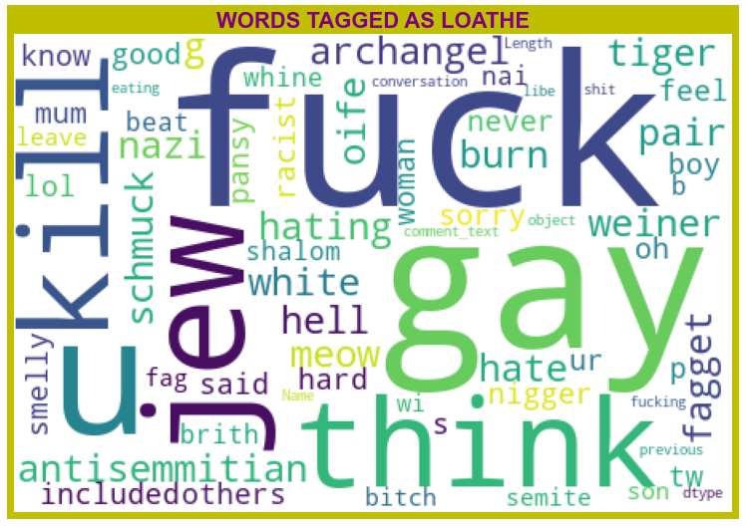
From word cloud of Loathe comments, it is clear that it mostly consists of words like fuck, gay, kill, think, jew, u etc.

Slide 18
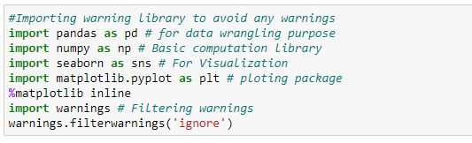
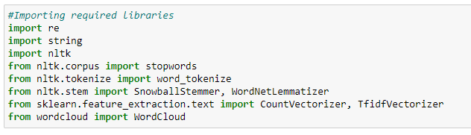
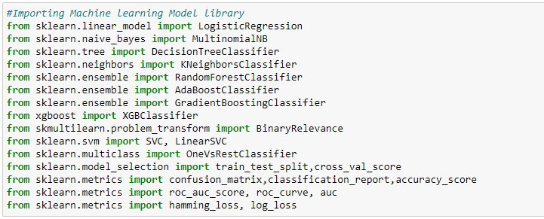
Visualization & Data Wrangling Library used
Text Mining Library used
Machine Learning Model Building Library used

Slide 19
Machine Learning Model Building
The different classification algorithm used in this project to build ML model are as below:
Random Forest classifier
Decision Tree Classifier
KNN Classifier
Gradient Boosting Classifier
XGB Classifier
MultinomialNB
Logistics Regression
AdaBoost Classifier

Slide 20
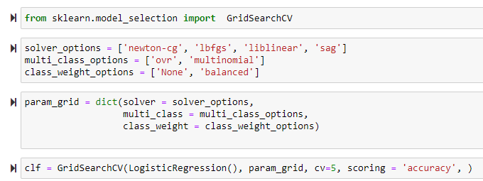
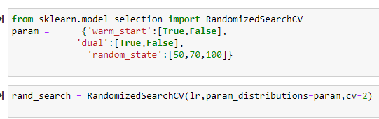
Machine Learning Models
Logistics Regression gives maximum Accuracy Score: 0.9567 % than the other classification models.
Hyper parameter Tuning is perform over this best model using best param shown below :

Slide 21
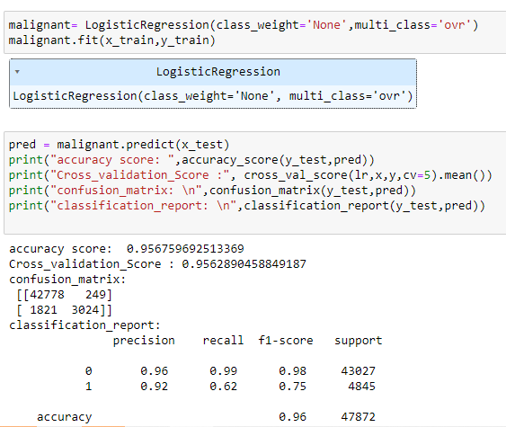
Final ML Model
Final Model is giving us Accuracy score of 0.95% which is slightly improved compare to earlier Accuracy score of 0.96%.

Slide 22
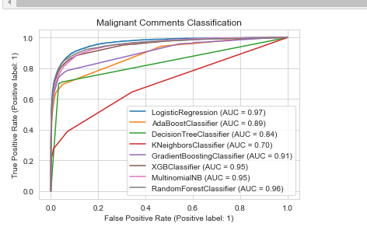
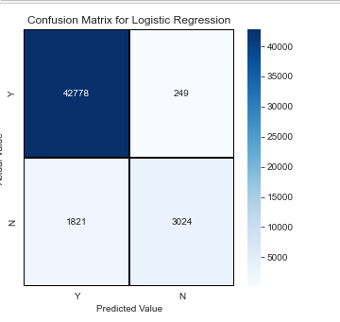
AOC-ROC Curve & Confusion Matrix

Slide 23
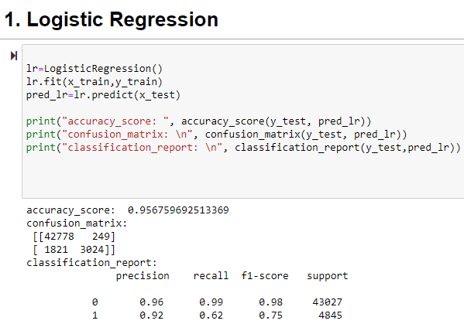

Slide 24
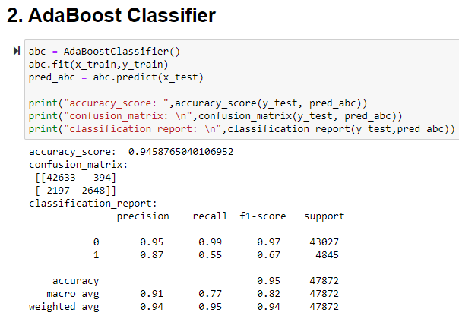

Slide 25
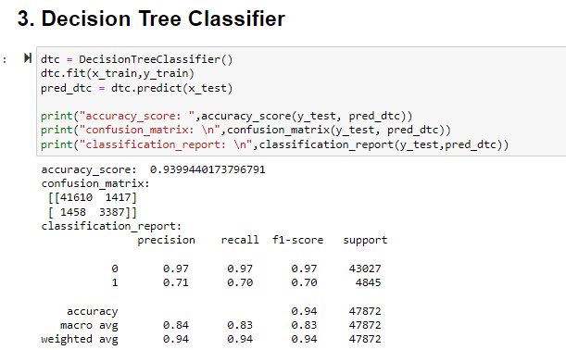

Slide 26
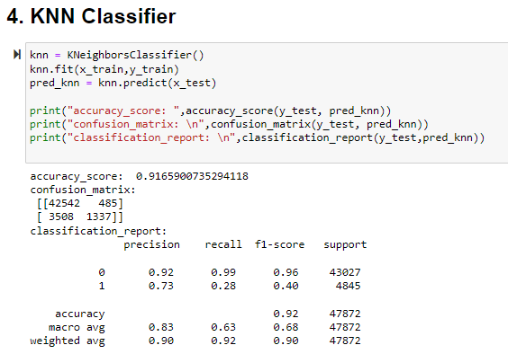

Slide 27
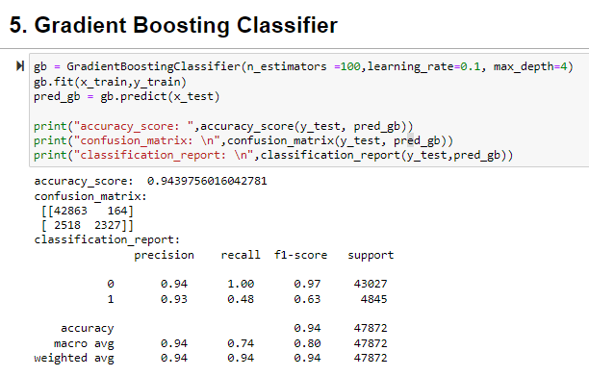

Slide 28
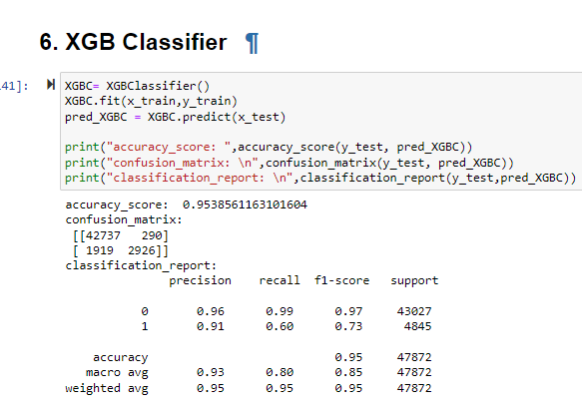

Slide 29
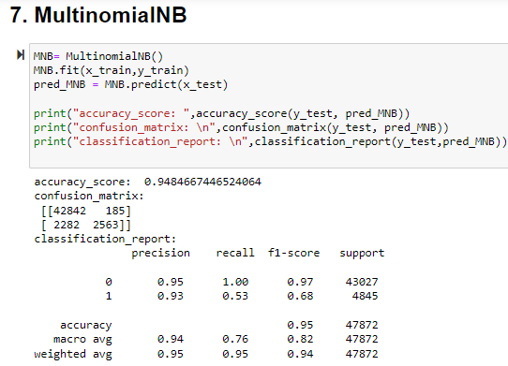

Slide 30
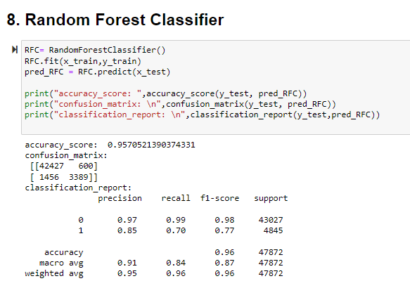

Slide 31
CONCLUSION
Logistic Regression performs better with Accuracy Score: 0.956 than the other classification models.
Final Model (Hyperparameter Tuning) is giving us Accuracy score of 0.95% which is slightly improved compare to earlier Accuracy score of 0.96%.
We also have Randomizedsearchcv for tuning.
This research work focuses on developing a model that would automatically classify a comment as either malignant or non-malignant using logistic regression. Therefore, this study aims to develop a multi-headed model to detect different types of malignant comment like threats, rude, abusive, and loathe. By collecting and pre-processing malignant comments for training and testing using term frequency- inverse document frequency (TF-IDF) algorithm, developing a multi-headed model will detect different types of malignant comment using logistic regression to train the dataset, and evaluate the model using confusion metrics

Slide 32
Thank You

